Slide 1
Module 2: Cybersecurity & Data Protection

Slide 2

Overview
Cybersecurity and data protection are essential for any organization that collects, processes, or stores personal or sensitive information
Data breach notification and communication: How to prepare for and respond to data breaches, and how to communicate effectively with stakeholders, regulators, and the public about the incident and its consequences
Cybersecurity training and ethical hacking: How to educate and empower employees and users about cybersecurity best practices, and how to use ethical hacking techniques to test and improve the security of systems and networks

Slide 3

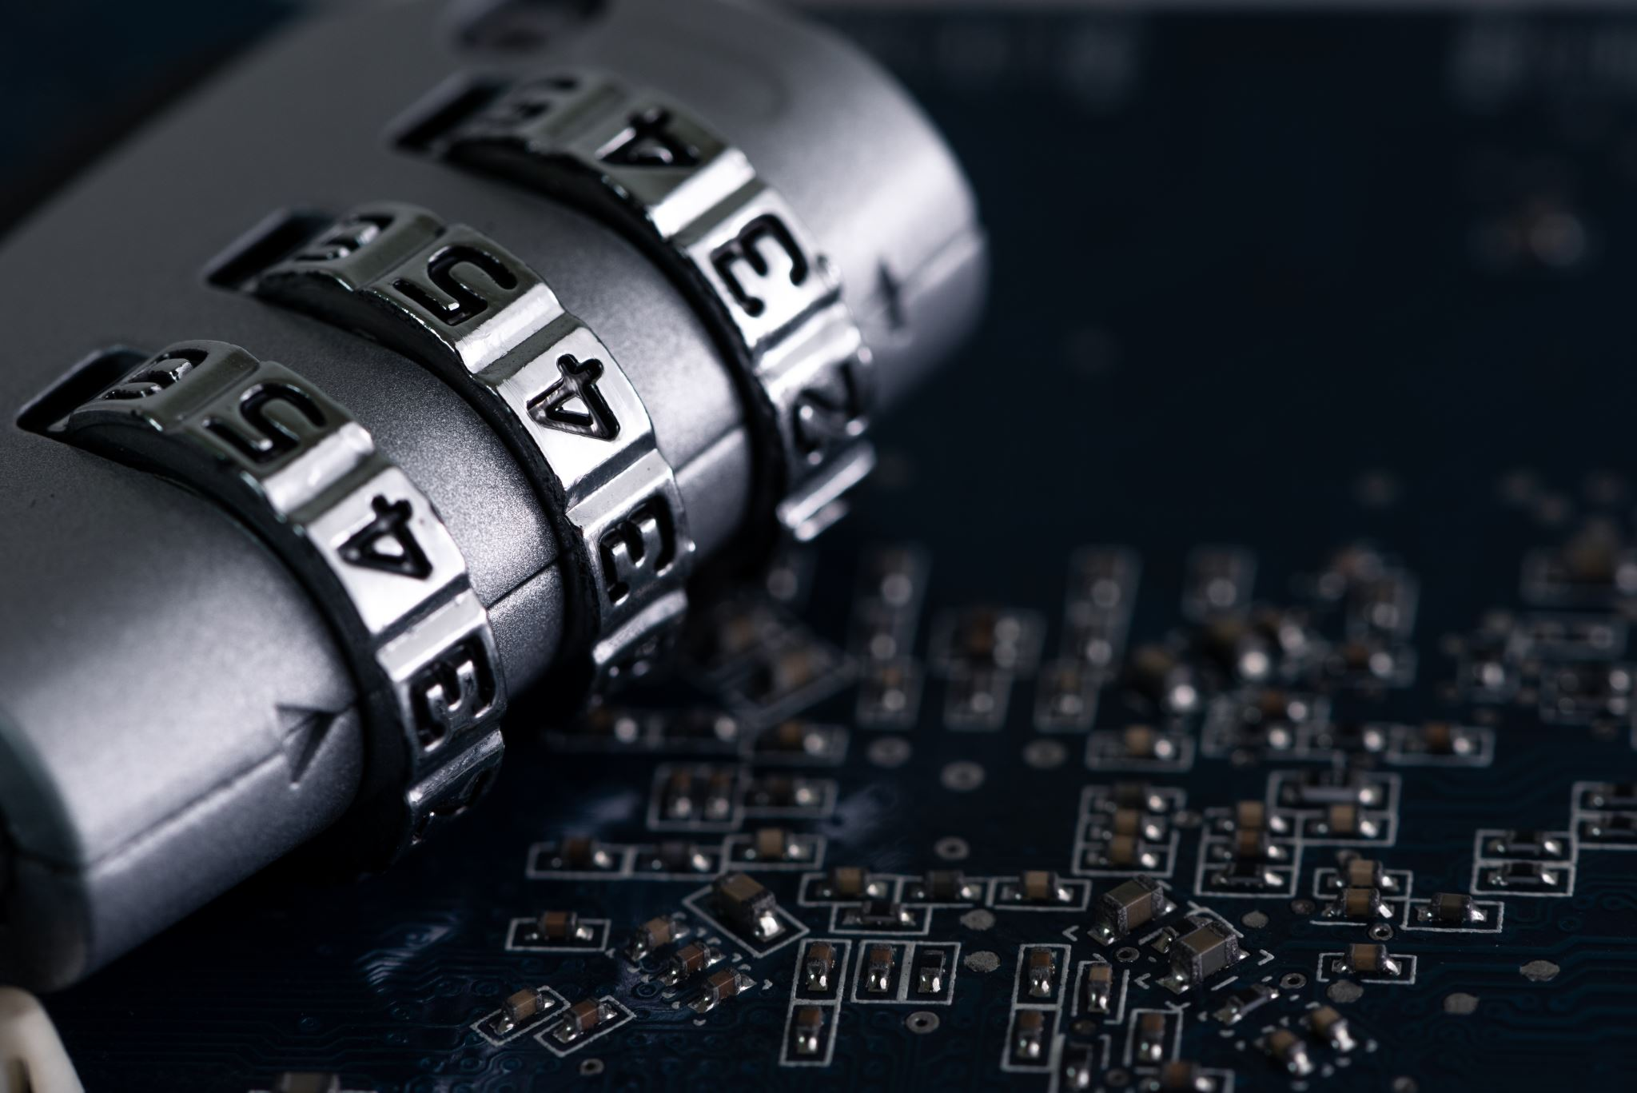
2.1 Cybersecurity Body of Knowledge
Access Control and Identity Management - covers the principles and practices involved in managing access to systems, networks, and resources, as well as establishing and maintaining user identities
Cybersecurity Architecture - addresses the design and implementation of secure systems and networks, considering factors such as threat modelling, security controls, and risk management
Cybersecurity Governance and Management - explores the organizational aspects of cybersecurity, including governance frameworks, policies, regulations, risk assessment, and incident response planning

Slide 4

2.1 Cybersecurity Body of Knowledge
Digital Forensics and Incident Response - focuses on the techniques and methodologies employed in the investigation and analysis of cyber incidents, as well as the appropriate response measures
Human Factors in Cybersecurity - recognizes the critical role of human behaviour and psychology in cybersecurity, covering topics such as security awareness, training, and usability considerations
Information Assurance - encompasses the principles and practices of safeguarding information assets, ensuring data integrity, confidentiality, availability, and non-repudiation
Malware and Software Vulnerability Analysis - delves into the identification, analysis, and mitigation of software vulnerabilities and malware threats

Slide 5

2.1 Cybersecurity Body of Knowledge
Network Security - explores the concepts, protocols, and technologies used to secure computer networks, including network architecture, encryption, intrusion detection, and firewall implementation
Operating Systems Security - focuses on securing operating systems, including access control, secure configuration, patch management, and secure administration practices
Privacy and Online Trust - covers the legal, ethical, and technical aspects of protecting individual privacy in the digital realm, as well as establishing trust in online interactions
Resilience and System Recovery - addresses the strategies and techniques for ensuring system resilience, business continuity planning, and disaster recovery

Slide 6
2.1 Cybersecurity Body of Knowledge
Secure Systems Engineering - emphasizes secure software development practices, secure coding techniques, and secure software lifecycle management
Software Security Assurance - explores methods for assuring the security of software systems, including secure testing, code reviews, and vulnerability assessment

Slide 7
2.2. Cybersecurity & Data Protection
Turn on automatic updates for your software, apps and operating systems to fix any vulnerabilities that cybercriminals can exploit
Use strong passwords and authentication methods for your accounts, such as multi-factor authentication or biometrics, to prevent unauthorized access
Avoid clicking on pop-ups, unknown emails and links that may contain malware or phishing attempts to steal your information or money
Always connect to secure Wi-Fi networks that are encrypted and password-protected and avoid using public Wi-Fi for sensitive activities such as online banking or shopping
Encrypt your data, especially when it is stored or transmitted over the internet or other networks, to prevent cybercriminals from reading or modifying it

Slide 8
2.2. Cybersecurity & Data Protection
Collaborate and share information with other organisations, security agencies and law enforcement to improve your cyber resilience and awareness of potential threats
Manage your assets, such as software and data, by using centralised systems and configuration management to ensure visibility and control of your critical resources
Implement protective measures and controls for your cyber risks, such as firewalls, antivirus software and backup systems, based on the Australian Signals Directorate’s Strategies to mitigate targeted cyber intrusions or equivalent

Slide 9
2.2. Cybersecurity & Data Protection
Use detection systems and processes to monitor your devices and networks for any signs of cyberattacks, such as unusual activity or anomalies, and use data analytics to integrate sources of threats in real time
Plan for response and recovery in case of a cyber incident, by having a clear strategy, roles and responsibilities, communication channels and contingency plans

Slide 10
Cybersecurity Policies
Be based on a comprehensive risk assessment and a clear understanding of the cyber threat landscape, as well as the legal, ethical and social implications of cyber activities
Aim to achieve a balance between security, privacy, accessibility and innovation, while respecting the rights and responsibilities of all stakeholders in the cyberspace
Promote the adoption of best practices and standards for cyber resilience, such as zero trust and attack surface management, which can help prevent, detect and mitigate cyber risks
Address the challenges and opportunities posed by emerging technologies, such as artificial intelligence, cloud computing and quantum computing, which can enhance or undermine cyber security

Slide 11

Cybersecurity Policies
Be aligned with national and international laws and regulations, as well as with the norms and values of the global community, to foster cooperation and trust among cyber actors
Be regularly reviewed and updated to reflect the dynamic nature of cyber threats and technologies, as well as the evolving needs and expectations of the cyber society

Slide 12

Cybersecurity Policies
Acceptable Use Policy
Security Awareness and Training Policy
Change Management Policy
Incident Response Policy
Remote Access Policy
Vendor Management Policy
Password Creation and Management Policy
Network Security Policy

Slide 13

The Privacy Act & Data Protection
Know why your personal information is being collected, how it will be used and who it will be disclosed to
Have the option of not identifying yourself, or of using a pseudonym in certain circumstances
Ask for access to your personal information

Slide 14

The Notifiable Data Breaches Scheme
The Notifiable Data Breaches scheme is a legal requirement for organisations and agencies that are covered by the Privacy Act 1988 to report data breaches that are likely to cause serious harm to the individuals whose personal information is involved
The NDB scheme aims to protect the privacy and security of personal information and to enhance public confidence in how organisations handle personal information
The NDB scheme also provides guidance and support for organisations and agencies on how to prevent, prepare for and respond to data breaches, drawing on research and best practice

Slide 15
Ethical & Legal Considerations
Ethical and legal considerations in cybersecurity and data protection are essential to ensure the privacy, security and trust of individuals, organisations and society
You should be aware of and comply with the relevant laws and regulations that apply to your jurisdiction, sector and activities, such as the Privacy Act 1988 in Australia, which sets out 13 Australian Privacy Principles for handling personal information
You should respect the confidentiality, integrity and availability of the data you collect, use, store and disclose, and only do so for legitimate purposes and with consent or authorisation from the data subjects or owners

Slide 16

Ethical & Legal Considerations
Confidentiality, integrity, and availability are the three main objectives of cybersecurity that aim to protect data and information from unauthorized access, use, and disclosure
Cybersecurity and data protection are broader topics that cover the legal, ethical, and technical aspects of ensuring the CIA of data in various contexts and domains

Slide 17

The Evolving Threat Landscape
Cyber resilience is the ability to anticipate, withstand, recover from, and adapt to adverse conditions, stresses, attacks, or compromises on systems that use or are enabled by cyber resources

Slide 18

Collaborative Approach
Share knowledge, build capacity and expertise, and assess cybersecurity risks at the country level
Provide incentives for the private sector to invest in digital infrastructure and technology
Unite data protection and cybersecurity skills

Slide 19

The Human Element
Keeping software up to date
Avoiding opening suspicious emails
Keeping hardware up to date
Using a secure file-sharing solution to encrypt data
Using anti-virus and anti-malware
Using a VPN to privatize your connections
Check links before you click
Don't be lazy with your passwords

Slide 20
2.3. Data Breach Notification & Communication
In response, data breach notification and communication policies have emerged as vital tools to address these challenges
Data breach notifications are required by law under the Privacy Act 1988 when a breach is likely to result in serious harm to affected individuals and remedial action cannot prevent or mitigate the harm
Data breach notifications should inform the affected individuals and the Office of the Australian Information Commissioner of the following: what happened, what information was involved, what are the risks and impacts, what are the steps taken or planned to address the breach, and what are the options for individuals to protect themselves

Slide 21
2.3. Data Breach Notification & Communication
Data breach response plans must be aligned with best practices and guidance from relevant authorities, such as the OAIC, the Data Protection Commissioner and industry bodies

Slide 22
The Modern Data Landscape
Notify the OAIC and affected individuals as soon as practicable after becoming aware of a data breach that is likely to result in serious harm, unless remedial action can prevent or mitigate the risk of harm
Use multiple communication channels to ensure that all affected individuals are notified, such as email, phone, SMS, website, social media, or postal mail
Use plain language that is clear, concise, and accurate, and avoid technical jargon or legal terms that may confuse or mislead the recipients

Slide 23
The Modern Data Landscape
Provide a comprehensive explanation of what happened, what information was involved, what actions have been taken to contain and resolve the breach, what steps are being taken to prevent future breaches, and what assistance or support is available to the affected individuals
Use effective headlines that capture the attention and convey the urgency of the message, such as "Important: Data Breach Notification" or "Urgent: Action Required Following Data Breach"
Inform the affected individuals about the next steps they should take to protect themselves from potential harm, such as changing passwords, monitoring accounts, contacting credit reporting agencies, or seeking legal advice

Slide 24
Data Breach Notification Policies
Data breach notification policies are a structured framework that organizations must adhere to when a data breach occurs
These policies outline the necessary steps for identifying, mitigating, and communicating the breach to the affected individuals and relevant authorities
Have a written data breach response plan that outlines the roles and responsibilities of the data breach response team, the steps to contain, assess, notify and review the breach, and the communication strategies for internal and external stakeholders

Slide 25

Timeliness The Ethical Imperative
Timeliness is an ethical imperative in data breach notification because it can reduce or prevent the harm to the affected individuals and restore the trust in the organisation that handles their personal information
The Privacy Act 1988 requires organisations to notify individuals and the Commissioner of eligible data breaches as soon as practicable after becoming aware of them, unless an exception applies
To achieve timeliness in data breach notification and communication, organisations should have a data breach response plan that outlines the roles and responsibilities of staff, the steps to contain, assess, notify and review a data breach, and the communication strategies and channels to use

Slide 26
Balancing Legal Compliance & Ethical Values
The applicable laws and regulations in different jurisdictions that may impose different obligations and standards for data breach notification and communication, such as the type, timing, content, and format of the notification
The ethical values and expectations of the stakeholders that may go beyond the legal requirements and demand more transparency, accountability, and responsiveness from the organization
The potential risks and benefits of disclosing or withholding certain information about the data breach, such as the cause, scope, severity, and consequences of the breach, as well as the remedial measures taken or planned by the organization

Slide 27

Balancing Legal Compliance & Ethical Values
Be proactive and prepared - develop a data breach response plan that outlines the roles, responsibilities, procedures, and resources for data breach notification and communication
Be timely and accurate - notify the affected stakeholders as soon as possible after discovering a data breach, without unreasonable delay
Be clear and concise - use plain and simple language that is easy to understand by the intended audience
Be respectful and empathetic - acknowledge the impact and harm caused by the data breach to the stakeholders
Be honest and accountable - admit responsibility and liability for the data breach, if applicable

Slide 28

Resilient Defenses & Responsible Practices
Principle 1: Respect for autonomy
Principle 2: Beneficence and non-maleficence
Principle 3: Justice
Principle 4: Accountability
Principle 5: Education

Slide 29

Resilient Defenses & Responsible Practices
Developing a cybersecurity strategy and governance framework that aligns with your organizational goals and objectives, and involves board engagement and oversight
Implementing a cyber risk management process that identifies, assesses, treats and monitors cyber risks, including those related to third parties such as vendors or partners
Collaborating and sharing information with other organizations, security agencies and law enforcement entities to enhance your situational awareness, threat intelligence and incident response capabilities
Managing your assets effectively by maintaining an inventory of your critical internal and external assets , and ensuring their visibility, availability and integrity

Slide 30
Resilient Defenses & Responsible Practices
Implementing protective measures and controls based on the Australian Signals Directorate’s Strategies to mitigate targeted cyber intrusions , as well as additional controls such as encryption for data in transit
Using detection systems and processes that enable continuous monitoring of your systems and networks, and leverage data analytics to integrate sources of threats in real time

Slide 31
The Human Element in Cybersecurity
Offering continuous training opportunities for all staff members, from the CEO to the receptionist, on their role in protecting the organization from cyber risks
Deploying advanced email protections, such as spam filters, phishing simulations and email encryption, to reduce the chances of falling victim to malicious messages
Revisiting the approach to password security, such as enforcing strong and unique passwords, using password managers and changing passwords regularly
Updating multifactor authentication controls, such as using biometric or token-based verification methods, to add an extra layer of security for accessing sensitive data or systems

Slide 32
The Human Element in Cybersecurity
Using insider threat protection technology, such as user behaviour analytics or data loss prevention tools, to monitor and detect abnormal or suspicious activities by authorized users

Slide 33
2.4 Ethical Hacking

Slide 34
A Proactive Approach to Security
Establishing clear policies and procedures for ethical hacking activities, such as defining the scope, objectives, methods, and reporting mechanisms
Obtaining written authorization from the owners or operators of the systems to be hacked and ensuring that the hacking activities do not violate any contractual or legal obligations
Conducting regular security assessments and audits to identify and remediate vulnerabilities, and using only approved tools and techniques that minimize the impact on the systems
Educating and training staff on ethical hacking skills and principles and ensuring that they follow the code of conduct and professional standards of the industry

Slide 35
A Proactive Approach to Security
Collaborating with other stakeholders, such as law enforcement agencies, regulators, or industry associations, to share information, best practices, and lessons learned
Cybersecurity Laws and Regulations Report 2023 Australia, which covers common issues in cybersecurity laws and regulations in Australia
Cybersecurity
Who is Liable when Business Emails are Hacked?

Slide 36
A Proactive Approach to Security
Obtain written consent from the client or the target organization before conducting any penetration testing or vulnerability assessment
Follow the principle of least privilege and only access the minimum amount of data and systems necessary to perform the ethical hacking task
Report any findings or incidents to the client or the target organization in a timely and transparent manner
Adhere to the relevant laws, regulations, standards, and codes of ethics that apply to the ethical hacking domain
Maintain a high level of professionalism and integrity throughout the ethical hacking process

Slide 37

Thank You

